Slide 1
SDRAM CONTROLLER
Group - 13
Divyanshi Gupta
Neeharika appineni
Mahesh kambhampati
Vishaali rani chakilam

Slide 2
INDEX
Objective
SDRAM Controller design
Controller Memory Interface
Main Memory Specifications
Test Plan
Project contribution
Resources

Slide 3
OBjECTIVE
Design an SDRAM Controller interfaced to a Micron 256Mb SDRAM (MT48LC16M16A2).
Implementing constraint randomization to generate stimulus.
Verifying the functionality of the SDRAM Controller using assertions.

Slide 4
Sdram controller design
32 bit address bus , but only 24 bits are used to access the memory addresses(16M x 16).
13 bits - row address, 9 bits - column address and 2 bits - bank address.
A single16-bit bus is used for read and write to memory.
Issues commands to the SDRAM to perform memory operations.
Reads and Writes are performed in bursts of length 2.
Open page policy.

Slide 5
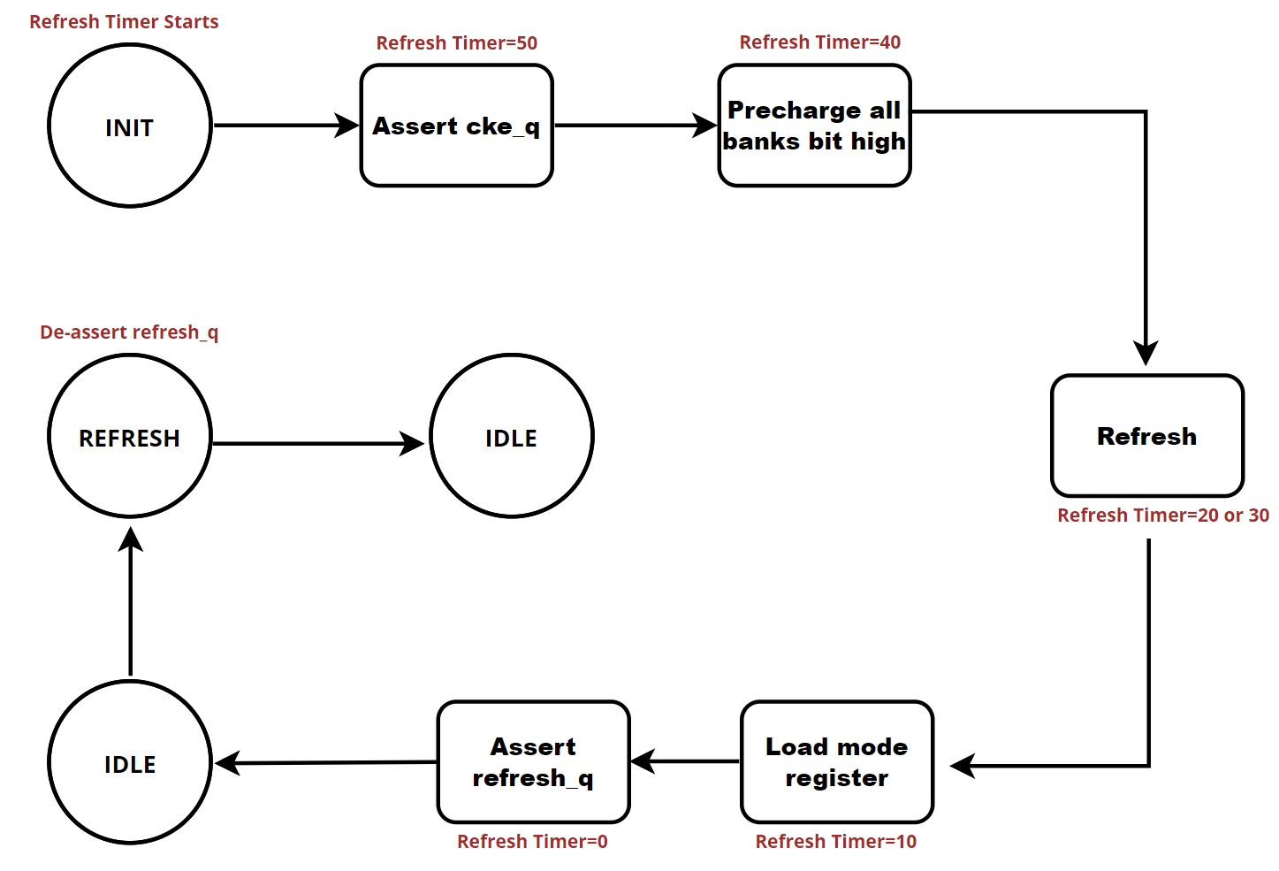
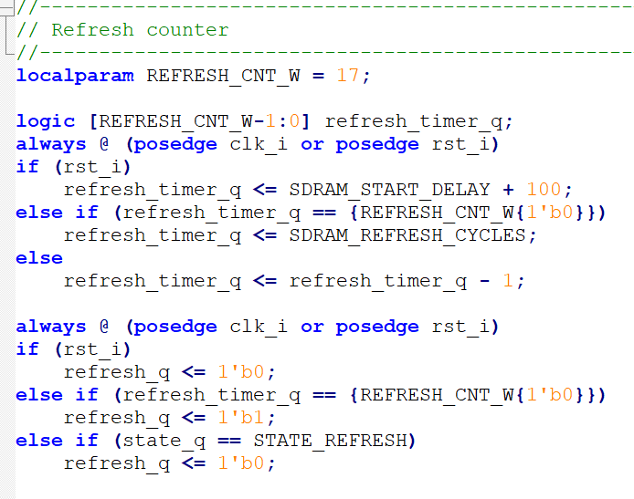
Reset state transitions

Slide 6
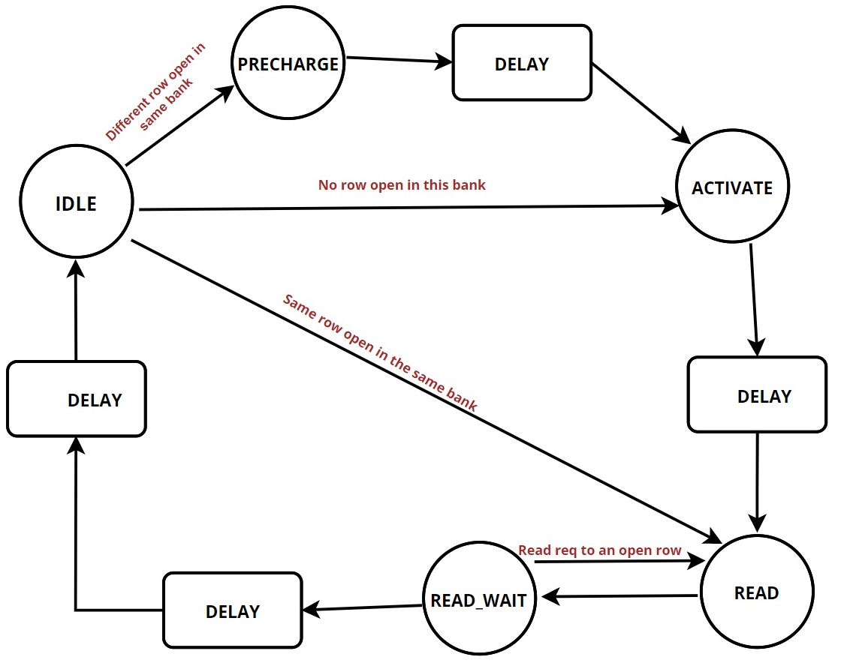
Read state transitions
Ram request result in a state transition.
PRECHARGE state has a delay of TRP = 1 cycle.
TRCD delay during the ACTIVATE state is 1 cycle.
Read latency is 2 cycles during the READ_WAIT state.

Slide 7
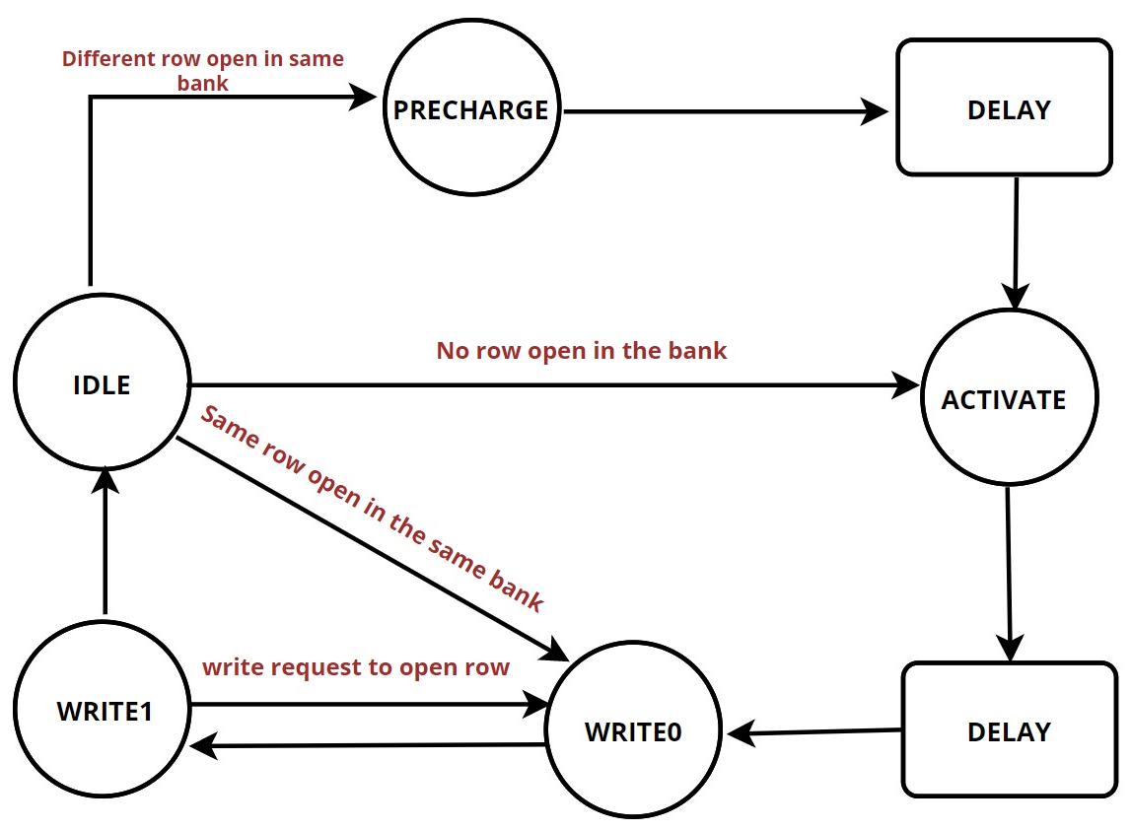
Write state transitions
Ram request result in a state transition.
PRECHARGE state has a delay of TRP = 1 cycle.
TRCD delay during the ACTIVATE state is 1 cycle.

Slide 8
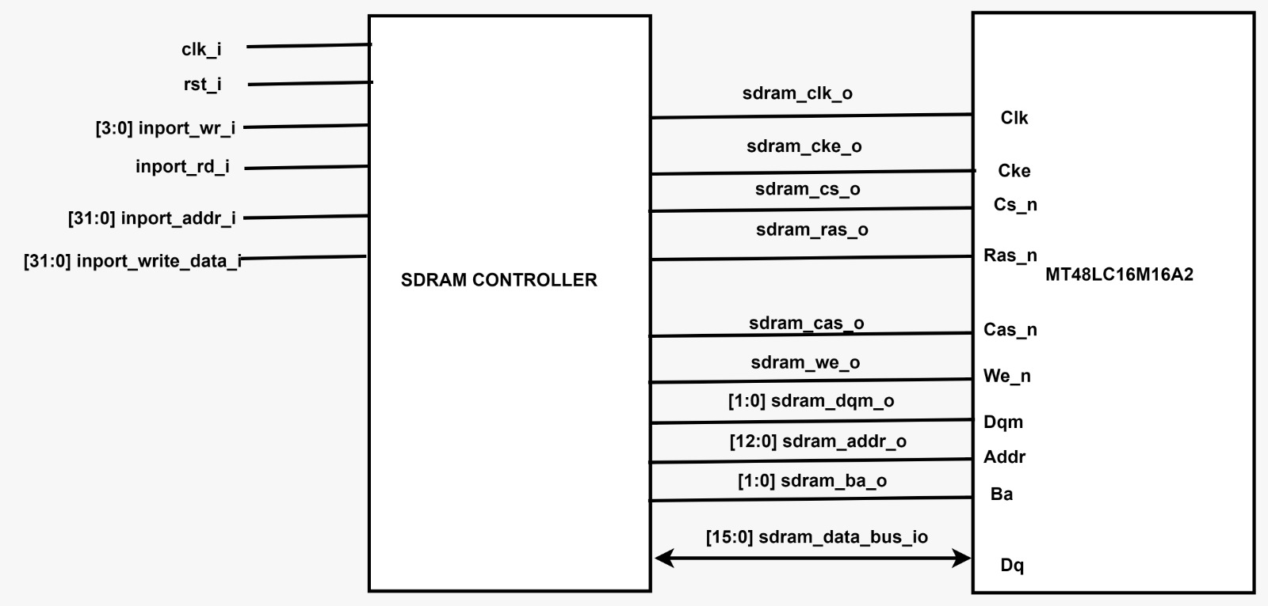
Controller memory interface

Slide 9
Main Memory Specifications
Micron 256Mb SDRAM (MT48LC16M16A2) has been used to interface with the controller.
It is a third party verified module.
The organization of the memory is 16M x 16.
The Mode register gives information about the burst length - 2, type – Sequential and CAS Latency – 2
It has a bidirectional 16-bit data bus.

Slide 10
Test plan
We used constraint randomization to give random write, read requests and data inputs to the controller.
Tasks are used to give the inputs to controller during ram requests.
An associative array is used to make a reference memory to verify the operations on the main memory.
Assertions are used to verify the functionality of the controller.

Slide 11
resources
https://opencores.org/projects/sdram_axi4
https://www.anandtech.com/show/3851/everything-you-always-wanted-to-know-about-sdram-memory-but-were-afraid-to-ask/3
https://github.com/lgeek/orpsoc/blob/master/bench/verilog/mt48lc16m16a2.v
https://www.micron.com/-/media/client/global/documents/products/data-sheet/dram/256mb_sdr.pdf
https://verificationacademy.com/forums/systemverilog/parameterized-assertionssva-bit-wise-using-generate-block
https://github.com/dgupta2611/SV_Project_Winter_2023.git

